Slide 1
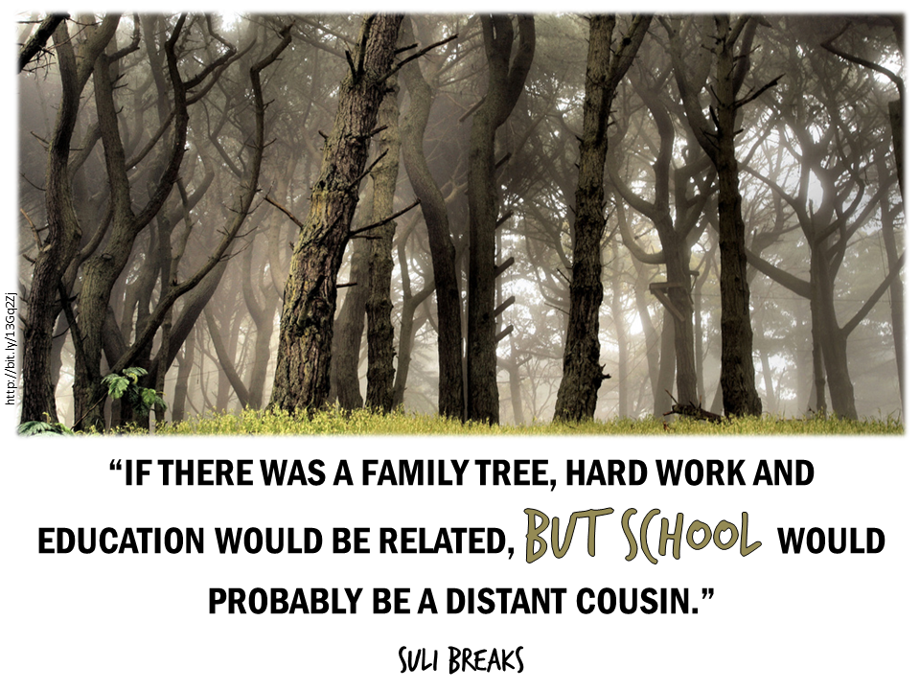
Notes:
Original Image Credit: At Lands End by Sharon Mollerus
http://www.flickr.com/photos/clairity/199505029/
Licensed Creative Commons Attribution on June 5, 2013
Quote by Suli Breaks
Why I Hate School but Love Learning
http://www.youtube.com/watch?v=y_ZmM7zPLyI
Slide by Bill Ferriter
The Tempered Radical
http://blog.williamferriter.com
@plugusin

Slide 2
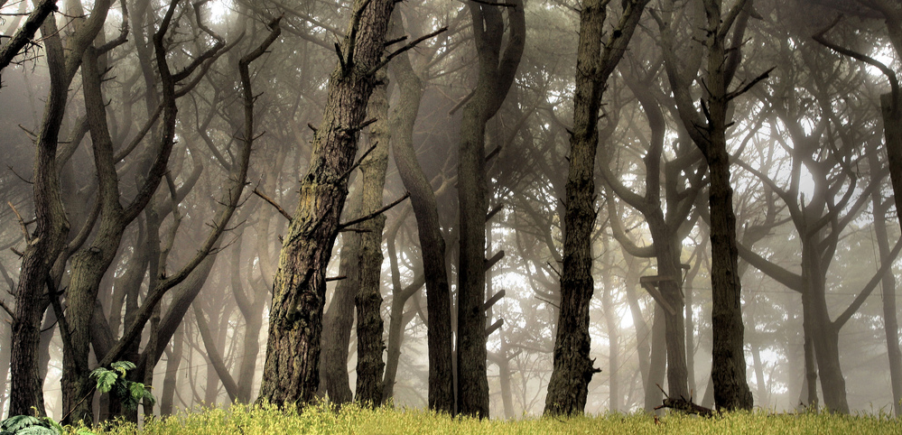
http://bit.ly/13Gq2Zj
“IF THERE WAS A FAMILY TREE, HARD WORK AND EDUCATION WOULD BE RELATED, but school WOULD PROBABLY BE A DISTANT COUSIN.”
suli breaks
Notes:
Original Image Credit: At Lands End by Sharon Mollerus
http://www.flickr.com/photos/clairity/199505029/
Licensed Creative Commons Attribution on June 5, 2013
Quote by Suli Breaks
Why I Hate School but Love Learning
http://www.youtube.com/watch?v=y_ZmM7zPLyI
Slide by Bill Ferriter
The Tempered Radical
http://blog.williamferriter.com
@plugusin

Slide 3
