Slide 1
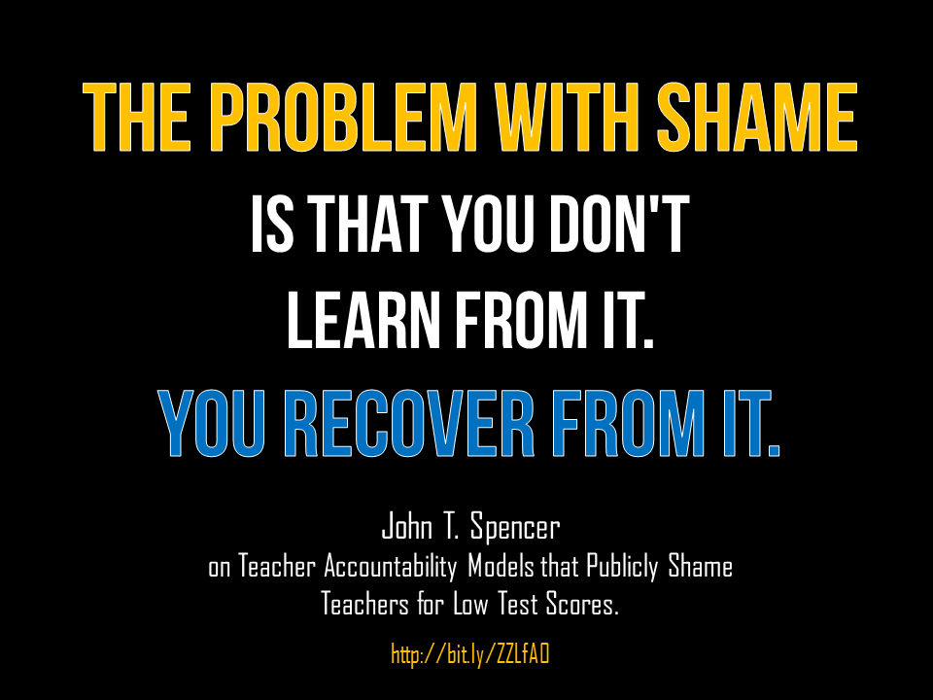

Slide 2
the problem with shame
is that you don't
learn from it.
You recover from it.
John T. Spencer
on Teacher Accountability Models that Publicly Shame Teachers for Low Test Scores.
http://bit.ly/ZZLfAO

