Slide 1
Notes:
Original Image Credit: Mother Board. Mother Bored. By psyberartist
http://www.flickr.com/photos/psyberartist/3648689054/
Licensed Creative Commons Attribution on March 12, 2013
Quote by Marc Prensky
http://bit.ly/10ChD80
Slide by Bill Ferriter
The Tempered Radical
http://blog.williamferriter.com

Slide 2
Technology GIVES KIDS POWER that people their age have never had. Let’s help them use it wisely.
Marc Prensky
http://bit.ly/10JjH1W
Notes:
Original Image Credit: Mother Board. Mother Bored. By psyberartist
http://www.flickr.com/photos/psyberartist/3648689054/
Licensed Creative Commons Attribution on March 12, 2013
Quote by Marc Prensky
http://bit.ly/10ChD80
Slide by Bill Ferriter
The Tempered Radical
http://blog.williamferriter.com

Slide 3
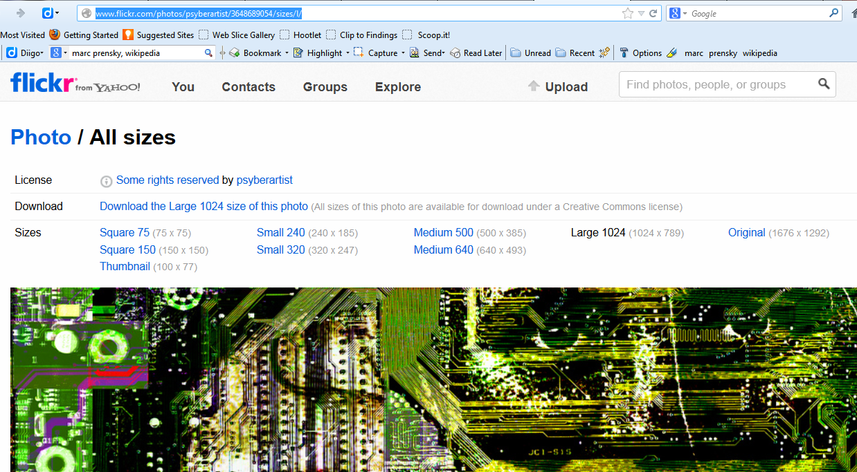
Notes:
Original Image Credit: Mother Board. Mother Bored. By psyberartist
http://www.flickr.com/photos/psyberartist/3648689054/
Licensed Creative Commons Attribution on March 12, 2013
Quote by Marc Prensky
http://bit.ly/10ChD80
Slide by Bill Ferriter
The Tempered Radical
http://blog.williamferriter.com

