Slide 1
Notes:
Original Image Credit: But 2007 by Christopher Dombres
http://www.flickr.com/photos/christopherdombres/4493564844/sizes/l/in/photostream/
Licensed Creative Commons Attribution on July 5, 2012
What If / Yeah But concept belongs to David Jakes
http://strengthofweakties.org/
Slide by Bill Ferriter
The Tempered Radical
http://williamferriter.com
@plugusin

Slide 2
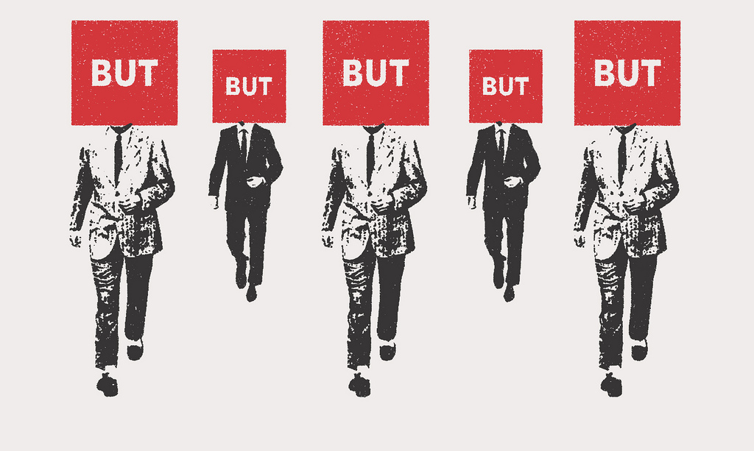
http://bit.ly/Owgjj2
http://bit.ly/Owgjj2
Driving change in challenging circumstances depends on leaders with a willingness to ask “What if” when faced with a never-ending stream of “Yeah, Buts.”
David Jakes
Notes:
Original Image Credit: But 2007 by Christopher Dombres
http://www.flickr.com/photos/christopherdombres/4493564844/sizes/l/in/photostream/
Licensed Creative Commons Attribution on July 5, 2012
What If / Yeah But concept belongs to David Jakes
http://strengthofweakties.org/
Slide by Bill Ferriter
The Tempered Radical
http://williamferriter.com
@plugusin

